Slide 1
Prototype - HCI

Slide 2
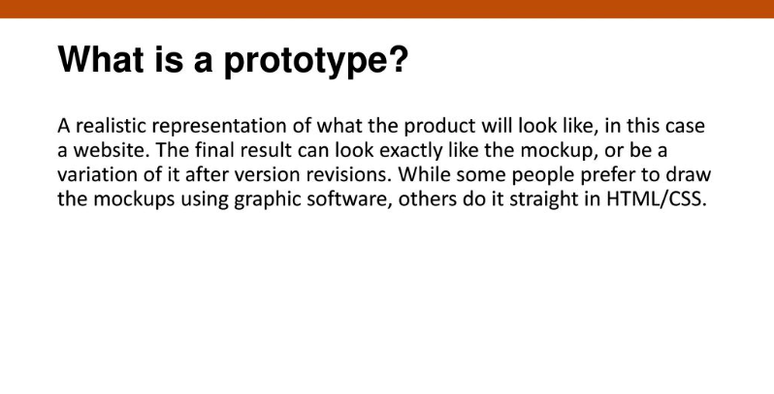

Slide 3
Prototyping
A limited representation of a design that allows users to interact with it and to explore its suitability
Allows stakeholders to interact with the envisioned product, gain some experience of using and explore imagined uses
Production of an intermediary product to be used as a basis for testing
Aim is to save on time and money
Aim is to have something that can be tested with real users

Slide 4
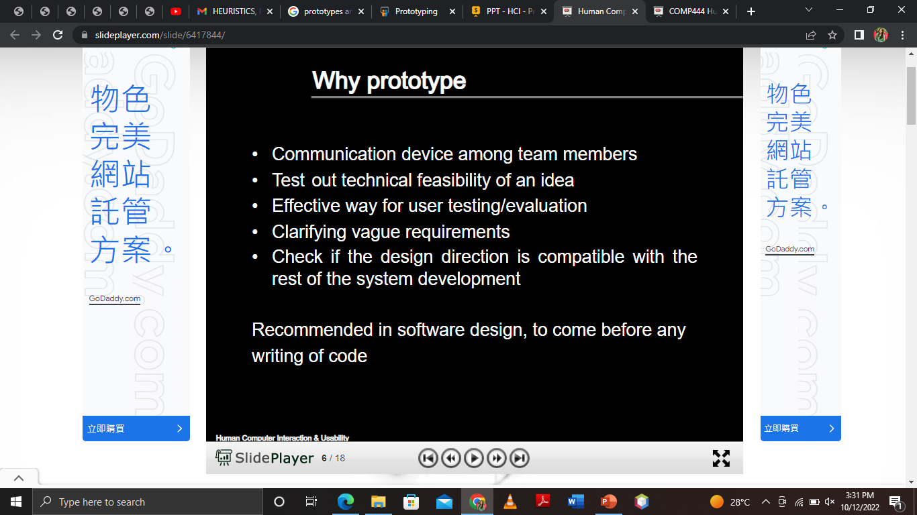

Slide 5
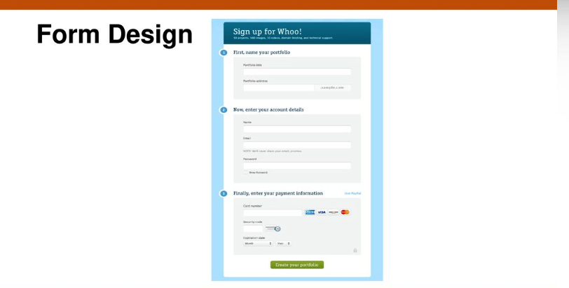

Slide 6
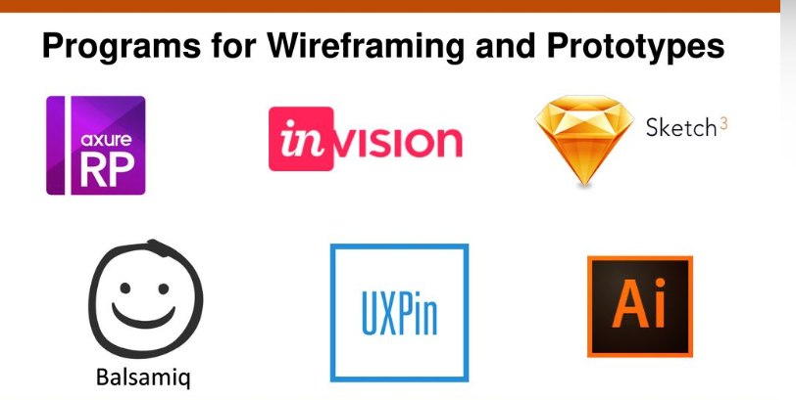

Slide 7
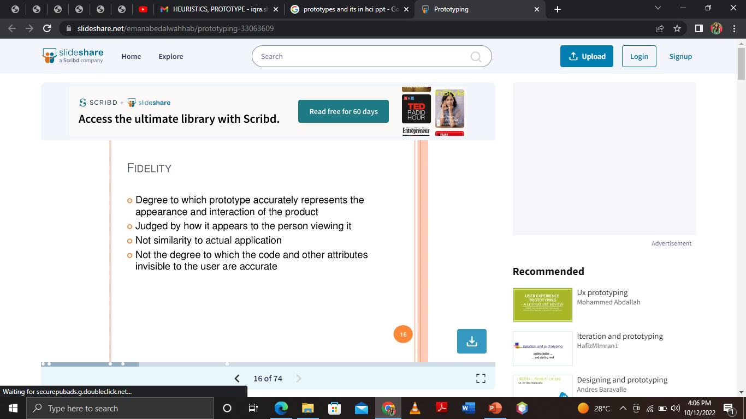

Slide 8
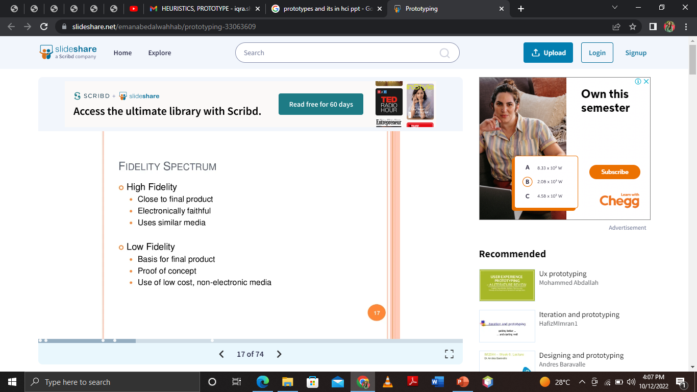

Slide 9
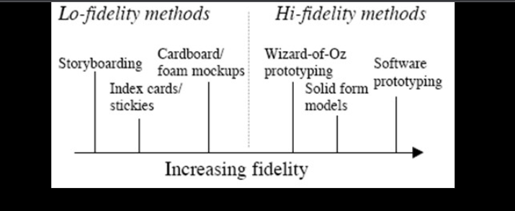
Types

Slide 10
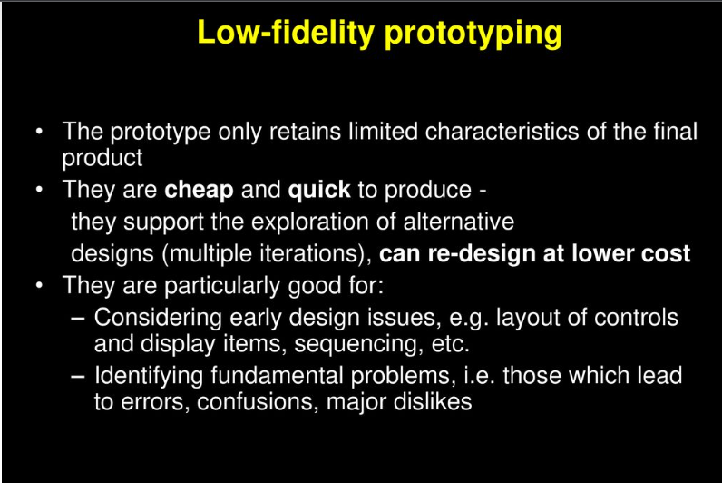

Slide 11
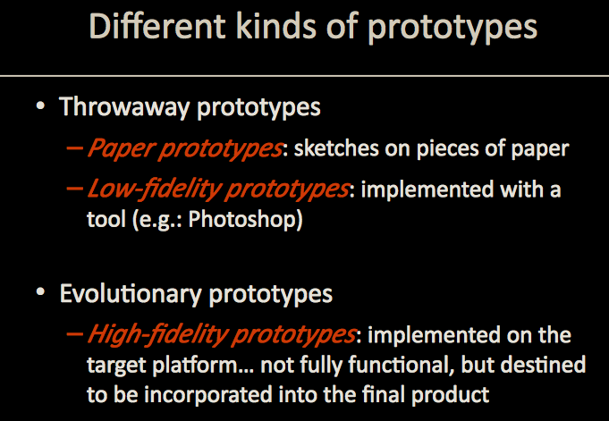

Slide 12
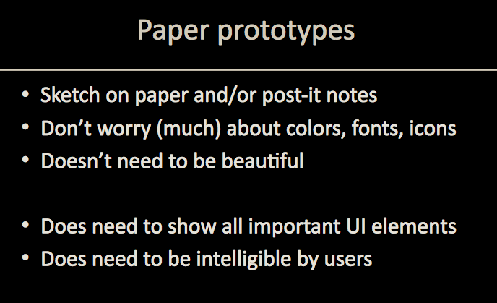

Slide 13
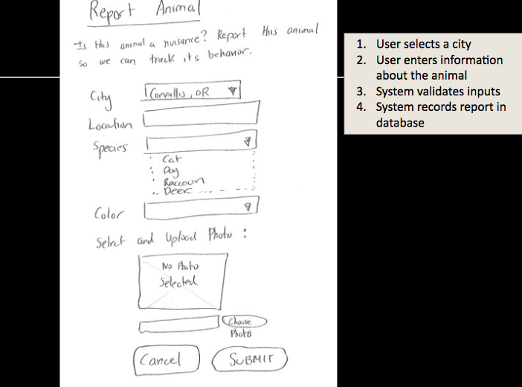

Slide 14
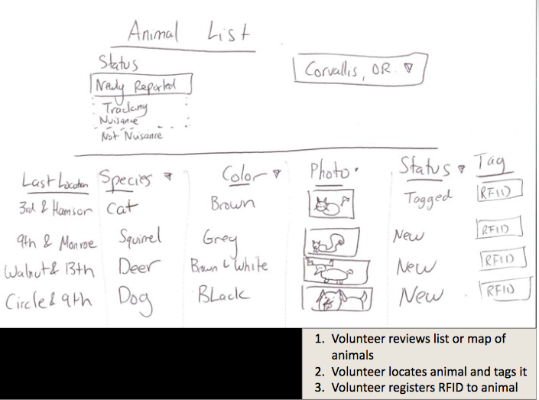

Slide 15
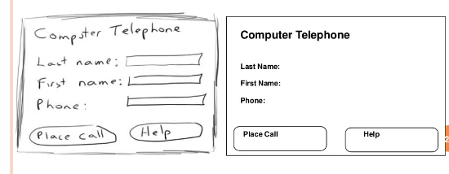

Slide 16
Low-fidelity Prototyping
Uses a medium which is unlike the final medium, e.g. paper, cardboard
Is quick, cheap and easily changed
Examples:
sketches of screens, task sequences, etc
‘post-it’ notes
storyboards
‘Wizard-of-Oz’

Slide 17
Storyboards
Often used with scenarios, bringing more detail, and a chance to role play
It is a series of sketches showing how a user might progress through a task using the device
Used early in design

Slide 18
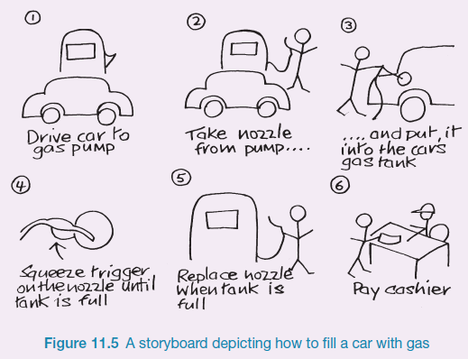
Sketching
Sketching is important to low-fidelity prototyping
Don’t be inhibited about drawing ability. Practice simple symbols

Slide 19
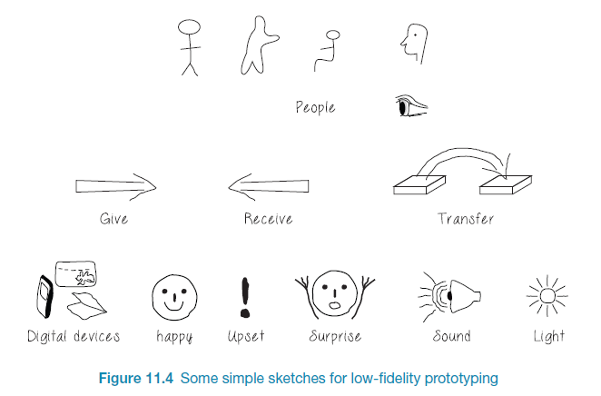
Generate storyboard from scenario

Slide 20
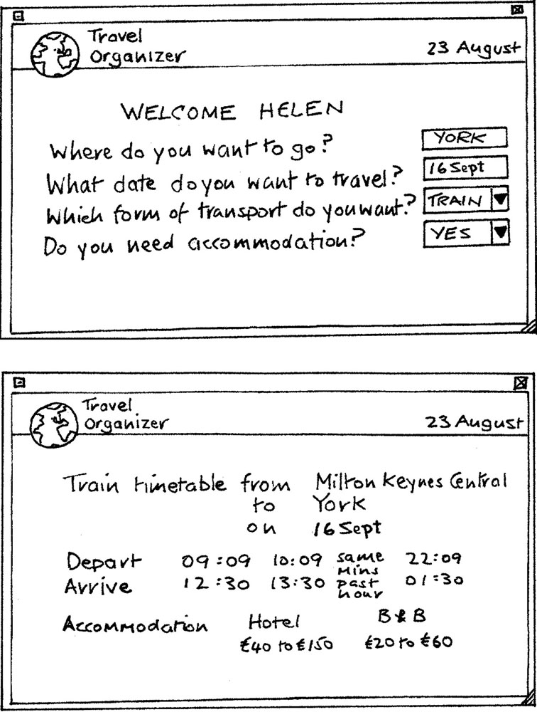
Card-based prototypes
Index cards (3 X 5 inches)
Each card represents one screen or part of screen
Often used in website development

Slide 21
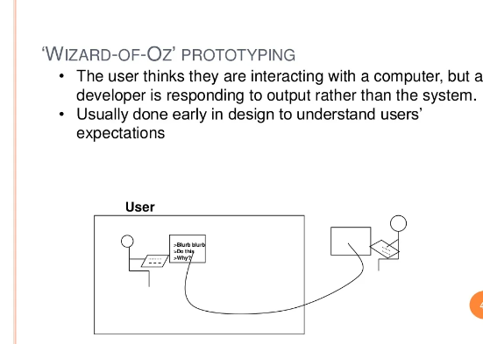

Slide 22
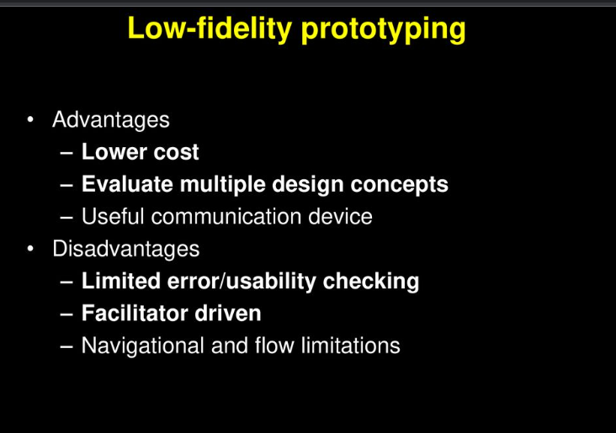

Slide 23
High-fidelity prototyping
Uses materials that you would expect to be in the final product
Prototype looks more like the final system than a low-fidelity version
High-fidelity prototypes can be developed by integrating existing hardware and software components
Danger that users think they have a complete system…….see compromises

Slide 24
High Fidelity (hi-fi) Prototyping
Hi-fi prototypes are realistic and detailed in design. The spacing, graphics and interface elements will look precisely like the actual product.
- The hi-fi prototype will include most if not all of the content on the final design.
- Hi-fi prototypes are incredibly realistic in their interactions.

Slide 25
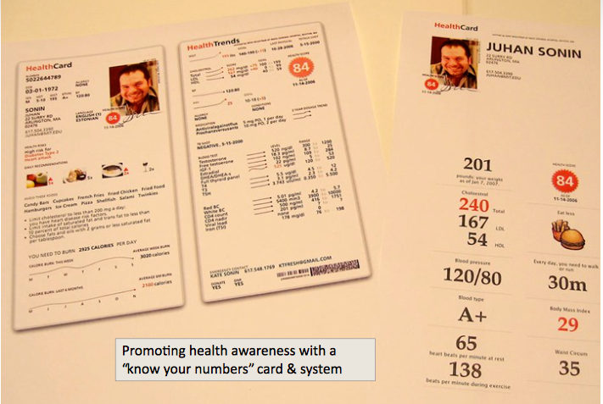

Slide 26
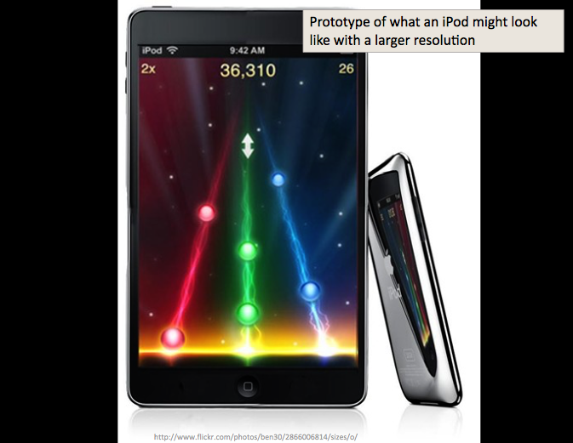

Slide 27
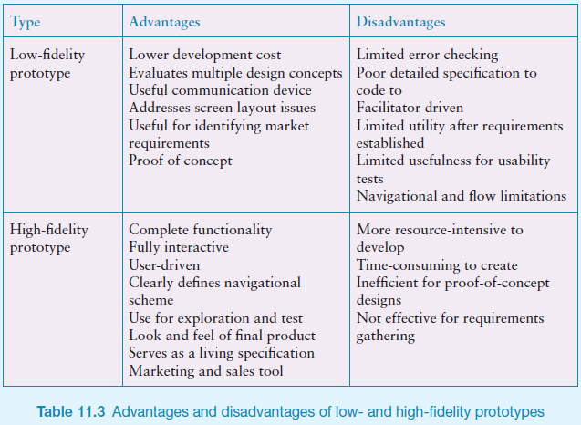
Low Vs High Fidelity prototypes

Slide 28
Compromises in prototyping
All prototypes involve compromises
For software-based prototyping maybe there is a slow response? sketchy icons? limited functionality?
Two common types of compromise
horizontal: provide a wide range of functions, but with little detail
vertical: provide a lot of detail for only a few functions
Compromises in prototypes mustn't be ignored. Product needs engineering

Slide 29
Metaphor
A metaphor is a figure of speech that describes an object or action in a way that isn't literally true, but helps explain an idea or make a comparison

Slide 30
Is there a suitable metaphor?
Interface metaphors combine familiar knowledge with new knowledge in a way that will help the user understand the product.
Refer to one thing by mentioning another
Conceptualizing what we are doing, e.g. surfing the web
A conceptual model instantiated at the interface, e.g. the desktop metaphor

Slide 32
Explore the user’s experience (UX)
Use personas, card-based prototypes or stickies to model the user experience
Visual representation called:
design map
customer/user journey map
experience map
Two common representations
wheel
timeline

Slide 34
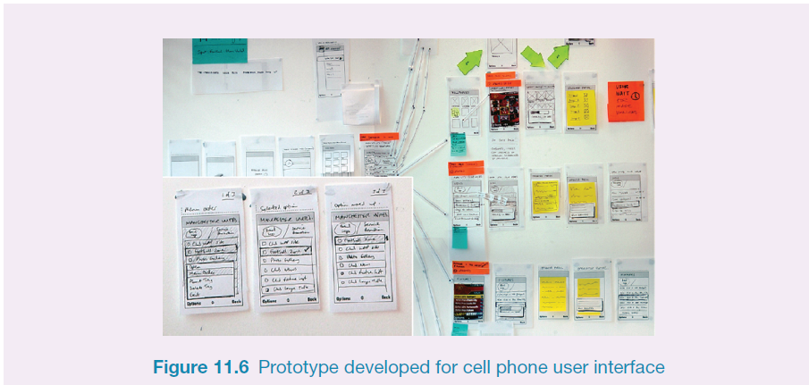
Generate card-based prototype from use case

Slide 35
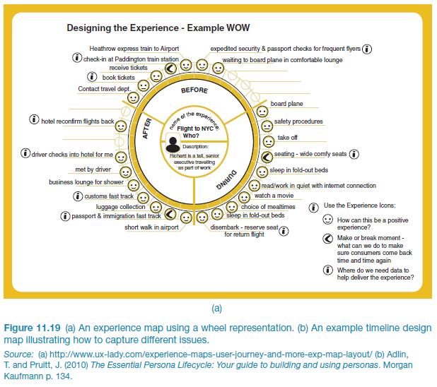
An experience map drawn as a wheel

Slide 36
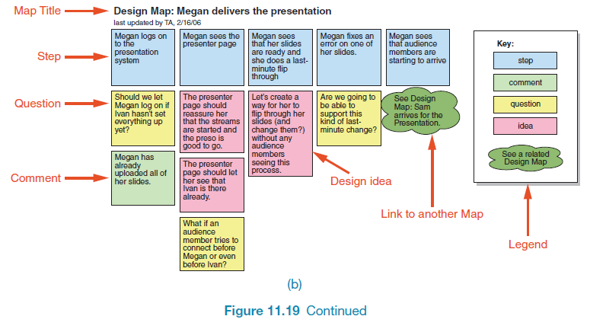
An experience map drawn as a timeline

Slide 37
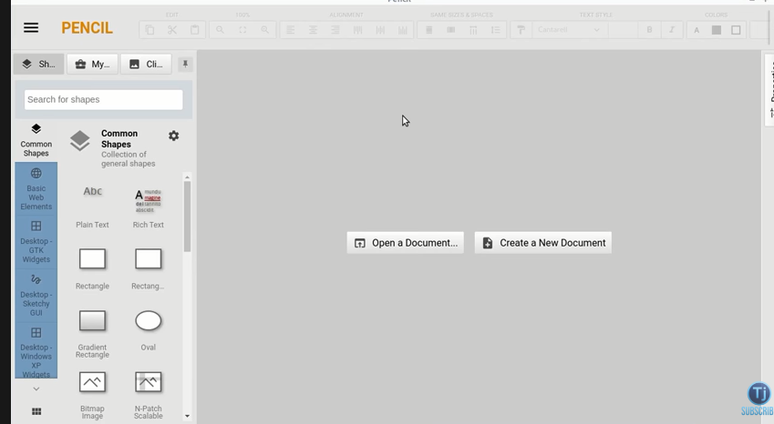
GUI Prototyping Tools
Pencil Project :
http://pencil.evolus.vn/
supports Linux, Mac OS X and Windows.
A Firefox add-on is also available
Free
Smartdraw
https://www.smartdraw.com/
$200

Slide 38
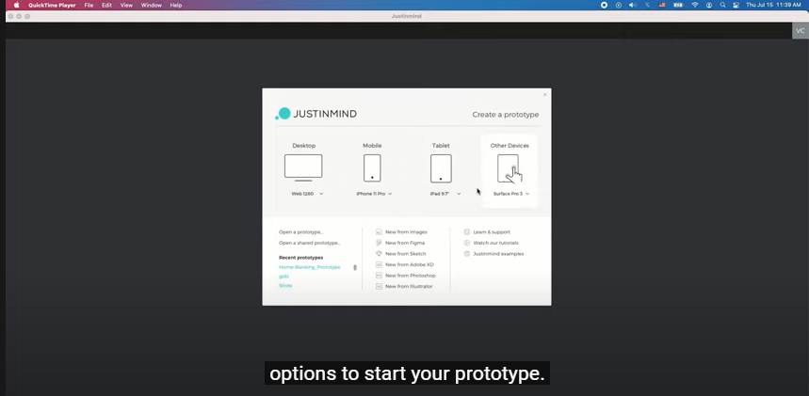
Just in mind

Slide 39
Story boards and mood Board
A Moodboard is a collage of images, text, and samples of objects. It can use references from other artists, movies, and images from the real world to convey color, design, or emotion.
A Storyboard is a pre-visualization of a motion picture, animation, or other media represented by a series of still images.

Slide 40
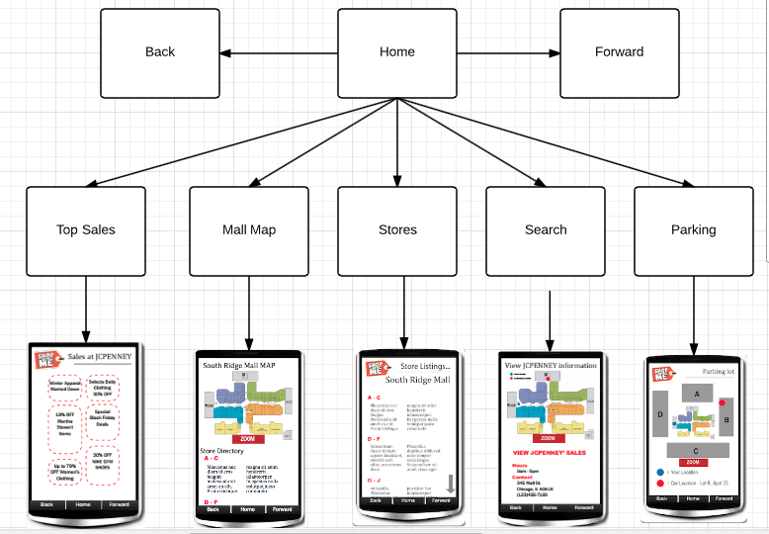
Navigation maps

Slide 41
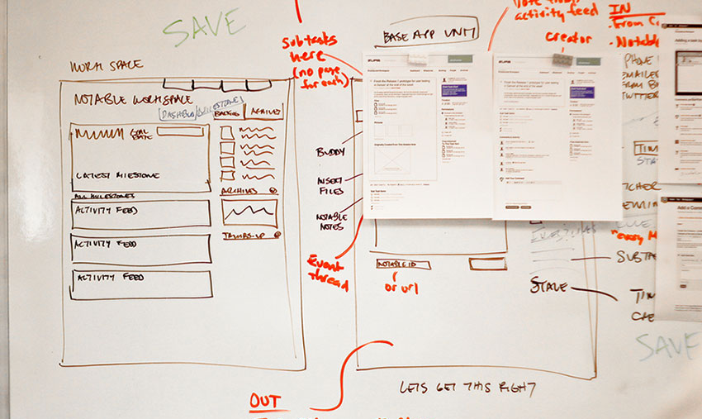
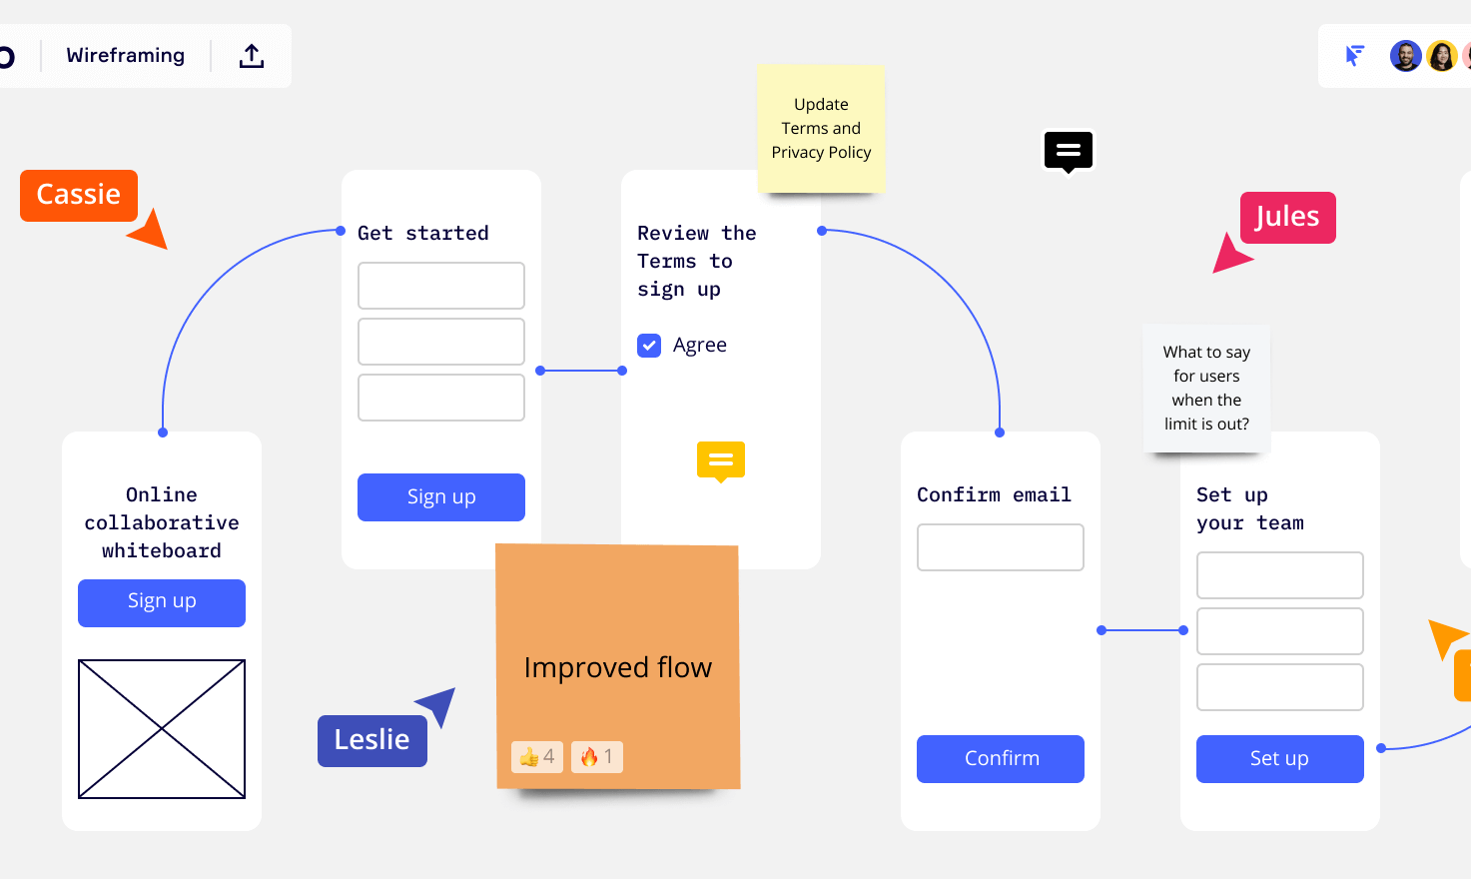
Wire frames
Wireframing is a process where designers draw overviews of interactive products to establish the structure and flow of possible design solutions.

